Slide 1
HOUSE SALES IN NORTWESTERN COUNTY
PROJECT

Slide 2
Experimental Design
Business Problem
Data Understanding
Data Preparation
Data Analysis
Regression
Conclusions and Recommendations

Slide 3
Problem Statement
Investigate various features that affect the house sales in Northwestern County and develop a prediction model which can give us a good prediction on the price of the house based on other variables.

Slide 4
Analysis Objectives
investigate the data and find out features that affect the prices of houses and come up with a prediction model for the house prices.
Develop a list of recommendations for residents of Northwestern County on what to consider while buying a house

Slide 5
Data Used
kc_house_data.csv

Slide 6
Data Preparation
The steps taken to prepare the data for analysis were:
Dropping the columns that are redundant and not required for the analysis.
Checking for null values.
Dropping the columns with null values

Slide 7
Which is the most common house (Bedroom wise)
3 bedroom houses are most commonly sold followed by 4 bedroom.
For a builder having this data , He can make a new building with more 3 and 4 bedroom’s to attract more buyers.

Slide 8
Factors Affecting House Prices
square feet which increases the price of the house
location of the house influencing the prices of the house like at longitude -122.2 to -122.4 sells houses at much higher amount.
Number of bedrooms the more the number the higher the prices
Number of bathrooms the more the number the higher the prices

Slide 9
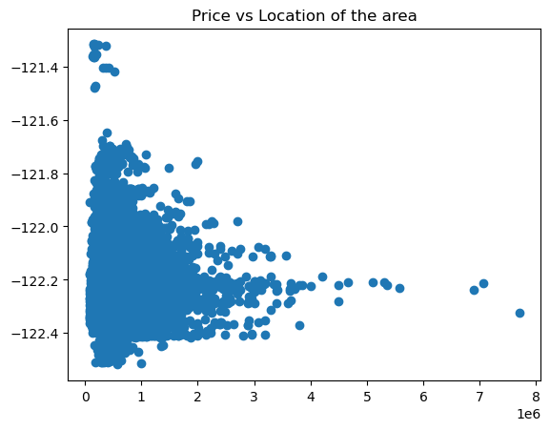
Price vs Location

Slide 10
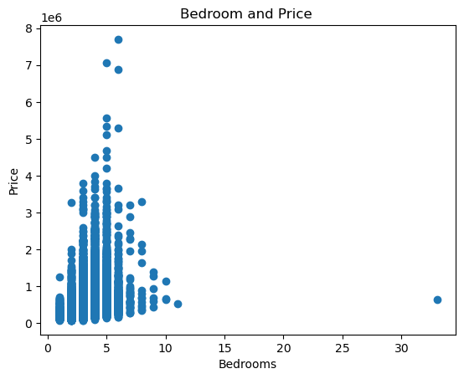
Bedroom vs Price

Slide 11
Regression
Simple Linear Regression
1.‘bedrooms’ vs ‘price’
2.‘grade’ vs ‘price’
Multiple Regression
1.‘bedrooms’,’grade’, ‘sqft_living’, ‘sqft_above’
2.‘bedrooms’,’bathrooms’, ‘sqft_living’, ‘sqft_lot’, ‘floors’, ‘waterfront’, ‘view’, ‘grade’, ‘sqft_above’, ‘sqft_basement’, ‘lat’, ‘sqft_living15’
Polynomial Regression
1.degree=2
2.degree=3

Slide 12
Observations & Recommendation
Complex model 1 gives R-squared testing: 0.555
Complex model 2 gives R-squared testing: 0.672
Complex model 3 gives R-squared testing: 0.759
Complex Model_3 gives us R-squared (testing) score of 0.759. From above reports, we can conclude that Polynomial regression for degree=2, is best solution.

